Slide 1
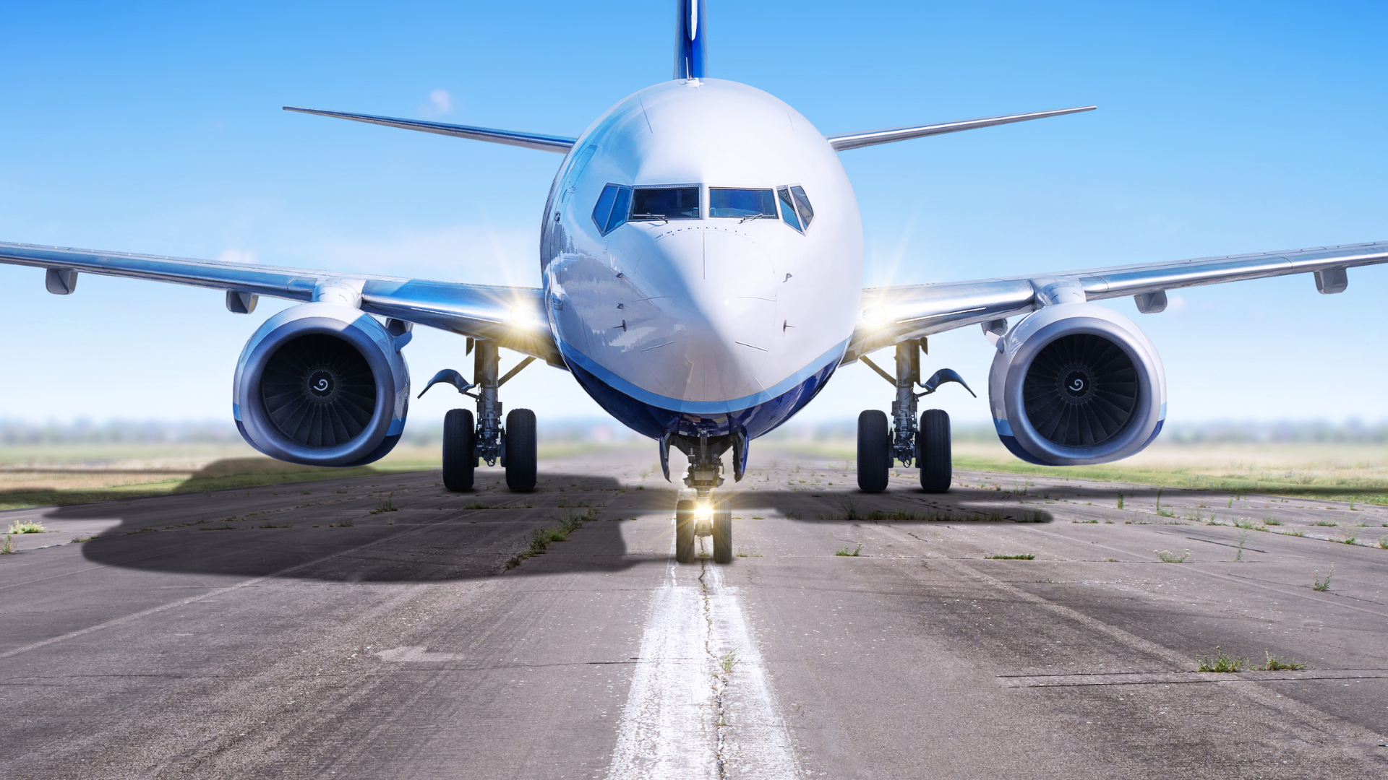
Airlines for business travel
Avoid flight delays with InformatiTEK
Presented by: Hannah McElroy
May 7, 2021

Slide 2

Introduction
Hannah McElroy
TEKsystems
Data Analytics Boot Camp Class Member
Airlines for Business Travel Project
Data Engineering
Data Analytics & Insights

Slide 3

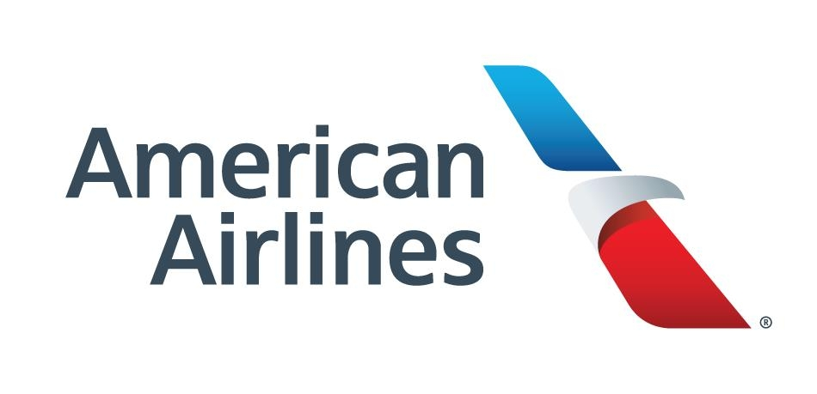

Airline for Business Travel Problem & Solution
InformatiTEK will provide analytics & insights on airlines to travel with for business
For those who travel for business, flying back and forth to work can be very time-consuming.
InformatiTEK can approach this problem by: ​
Data gathering from reputable data sources​
Data preparation
Airline dashboard

Slide 4


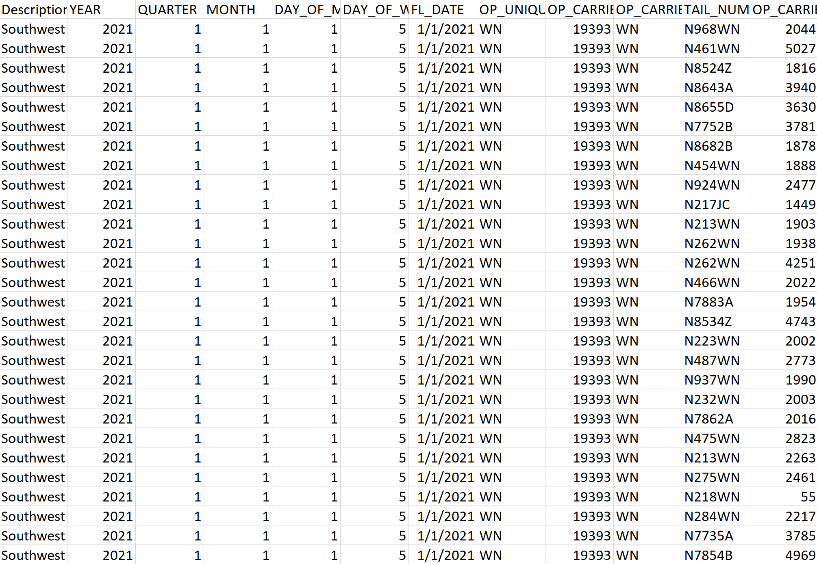
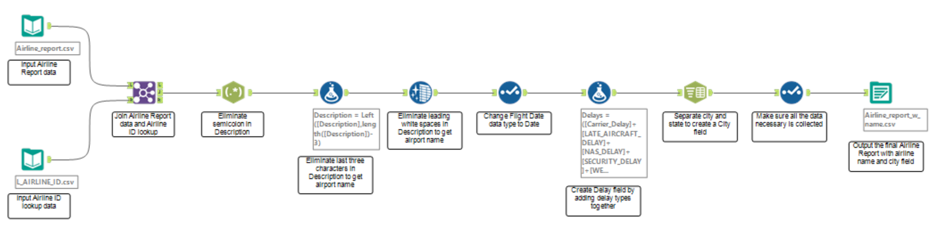

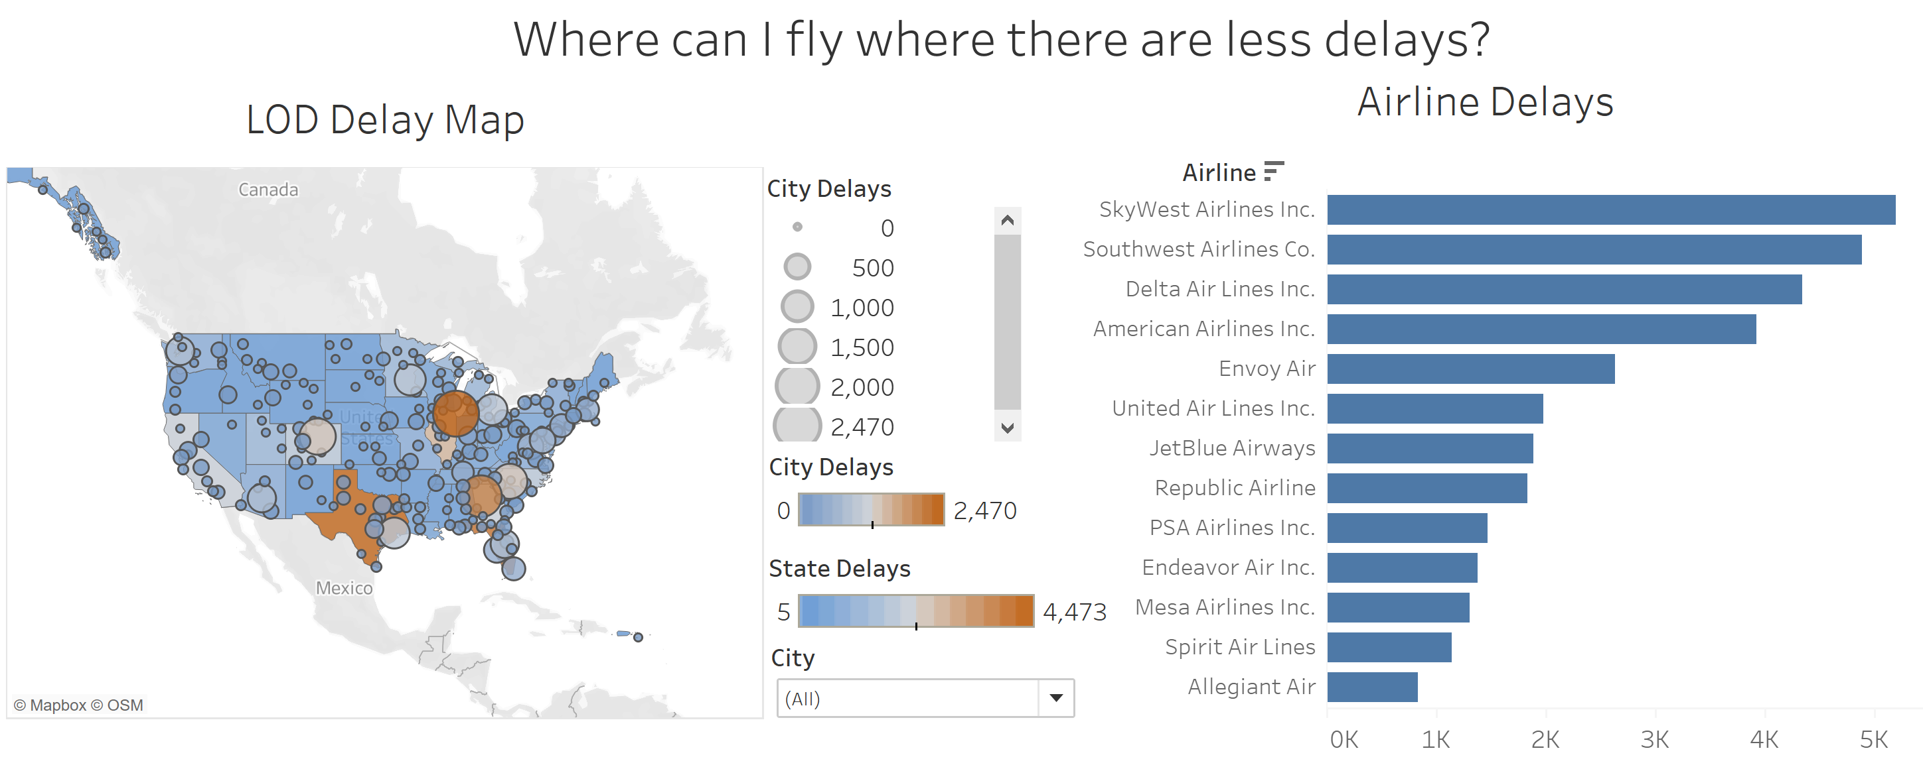
Process
What steps were taken to provide insights on this problem?

Slide 5
Data Sources
Bureau of Transportation Statistics (BTS)
Part of the U.S. Department of Transportation (DOT)
Accessible information on the U.S.’s transportation system
Collects and updates statistical information every month

Slide 6
Alteryx Workspace
Data Cleansing and Preparation

Slide 7
Recommendations
To avoid flight delays
The best day to avoid flight delays is Friday and Sunday
Fly at airlines with less carrier delays
Popular airlines recommended are Frontier, Horizon, Delta, American Airlines, and Southwest
Airport cities with a higher delay % are Chicago and Columbia (SC)
States with a higher delay % are Wyoming, Illinois, and Arkansas
On a regional scale, many Northern states have higher chances of delay

Slide 8
Questions
Hannah McElroy

